Slide 1

OUR community hospital

Slide 2
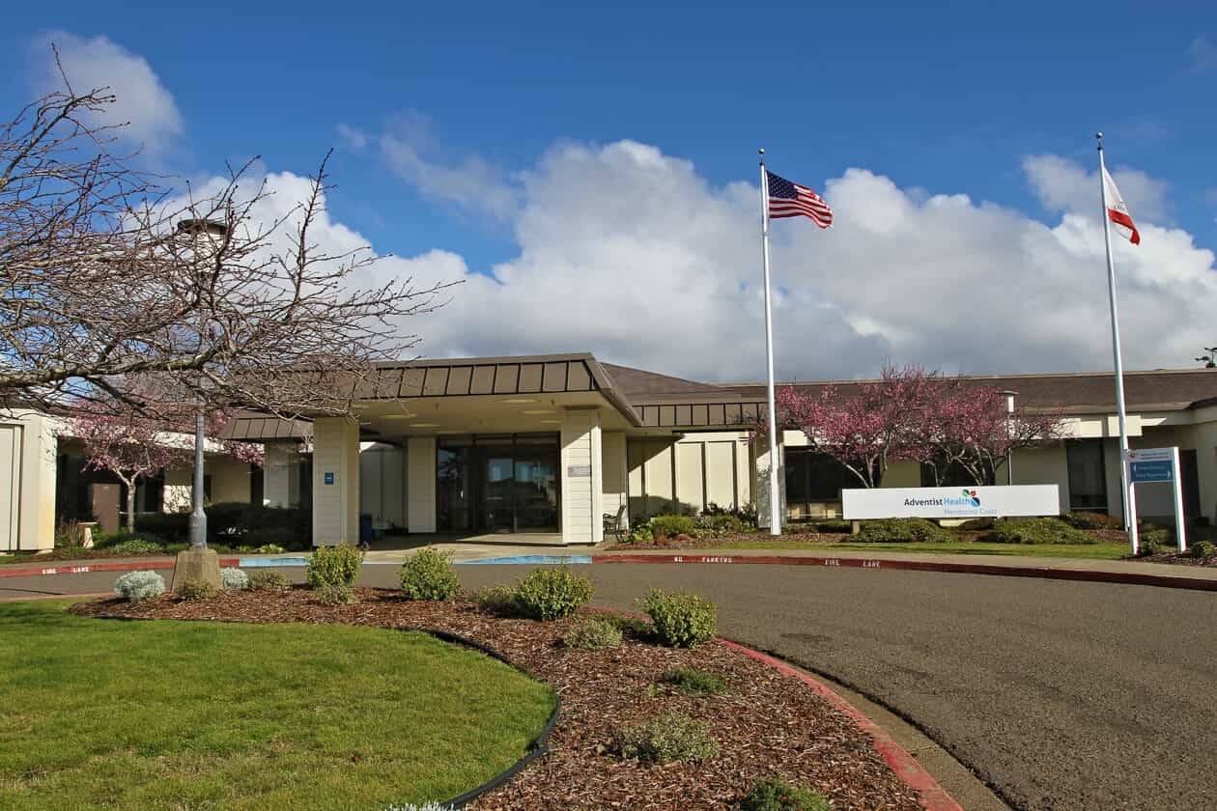

Slide 3

Basic facts
Community Owned – NOT owned by Adventist Health
Opened in 1972
Supported by your taxes and rent
  Parcel Tax Basic Assessment
  2016 Bond
  Measure C
  Rent from Adventist Health
Owners

Slide 4

Basic facts
Hospital is the major employer on the Coast
  320 employees; nearly all at ‘Living Wage’
  Contributes $120 M to the local economy annually
Hospital is unique
  Community owned
  Frontier – nearest hospital 1 hour +
  Critical Care – emergency services
  Rural

Slide 5

Basic facts
Adventist Health is our Partner
  Faith-based, non-profit
  Done an excellent job of improving and expanding services
  Possess the financial strength and resources to navigate a very hard time for hospitals
  Can recruit the talent needed
  Have no intention of leaving

Slide 6
Mendocino coast health care district
Originally formed to manage the hospital
Primary function is now to manage taxpayers contributions
Secondary function is to improve and/or expand health care services
Five member Board of Directors elected by you

Slide 7

Current fiscal situation
NO immediate need for a bond!!!!!
By 2030, we expect to deploy $40 M for the Hospital
  Deferred maintenance of about $9 M
  State-mandated seismic retrofit
  Facilities upgrade and improvements
Improved the financial administration
  Reduced bank accounts from 25 to 2
  All investments meet State requirements for 100% guarantee
  Reserves currently invested in 4-week T-bills earning currently 5.375% - we earned just over $41K last month on these investments

Slide 8
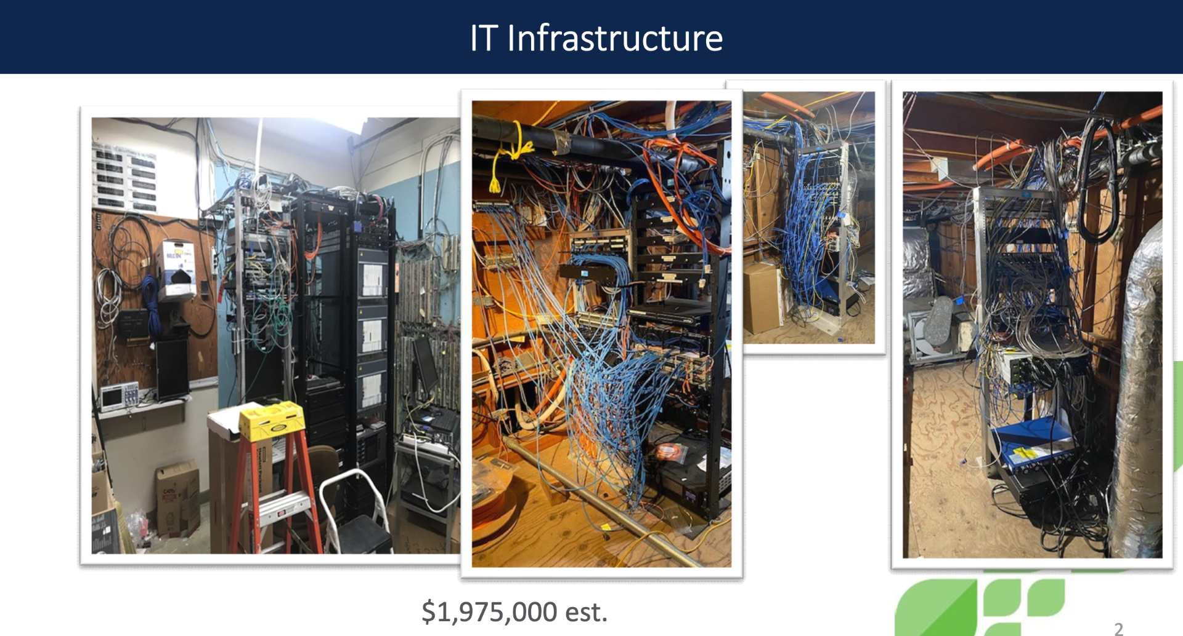
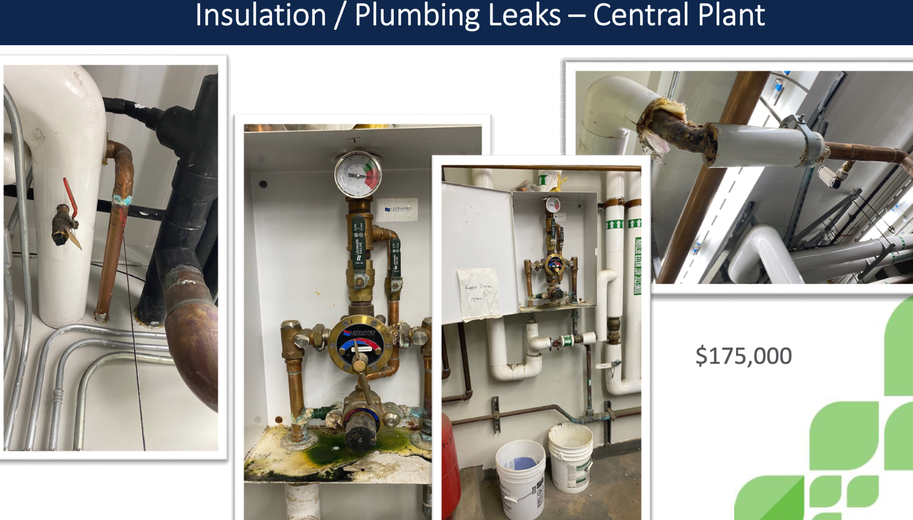

Slide 9
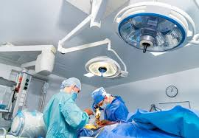
Hospital improvements
Expand the Clinics
  Ambulatory care is the direction health care is moving
  Clinics served 35,000 served last year and at capacity
Emergency Room
  Needs to expand from 8 beds to 10
Expand the size and upgrade Surgical Wards including new sterilization equipment
Integrate, to the extent possible, Clinic Care and Emergency Room

Slide 10
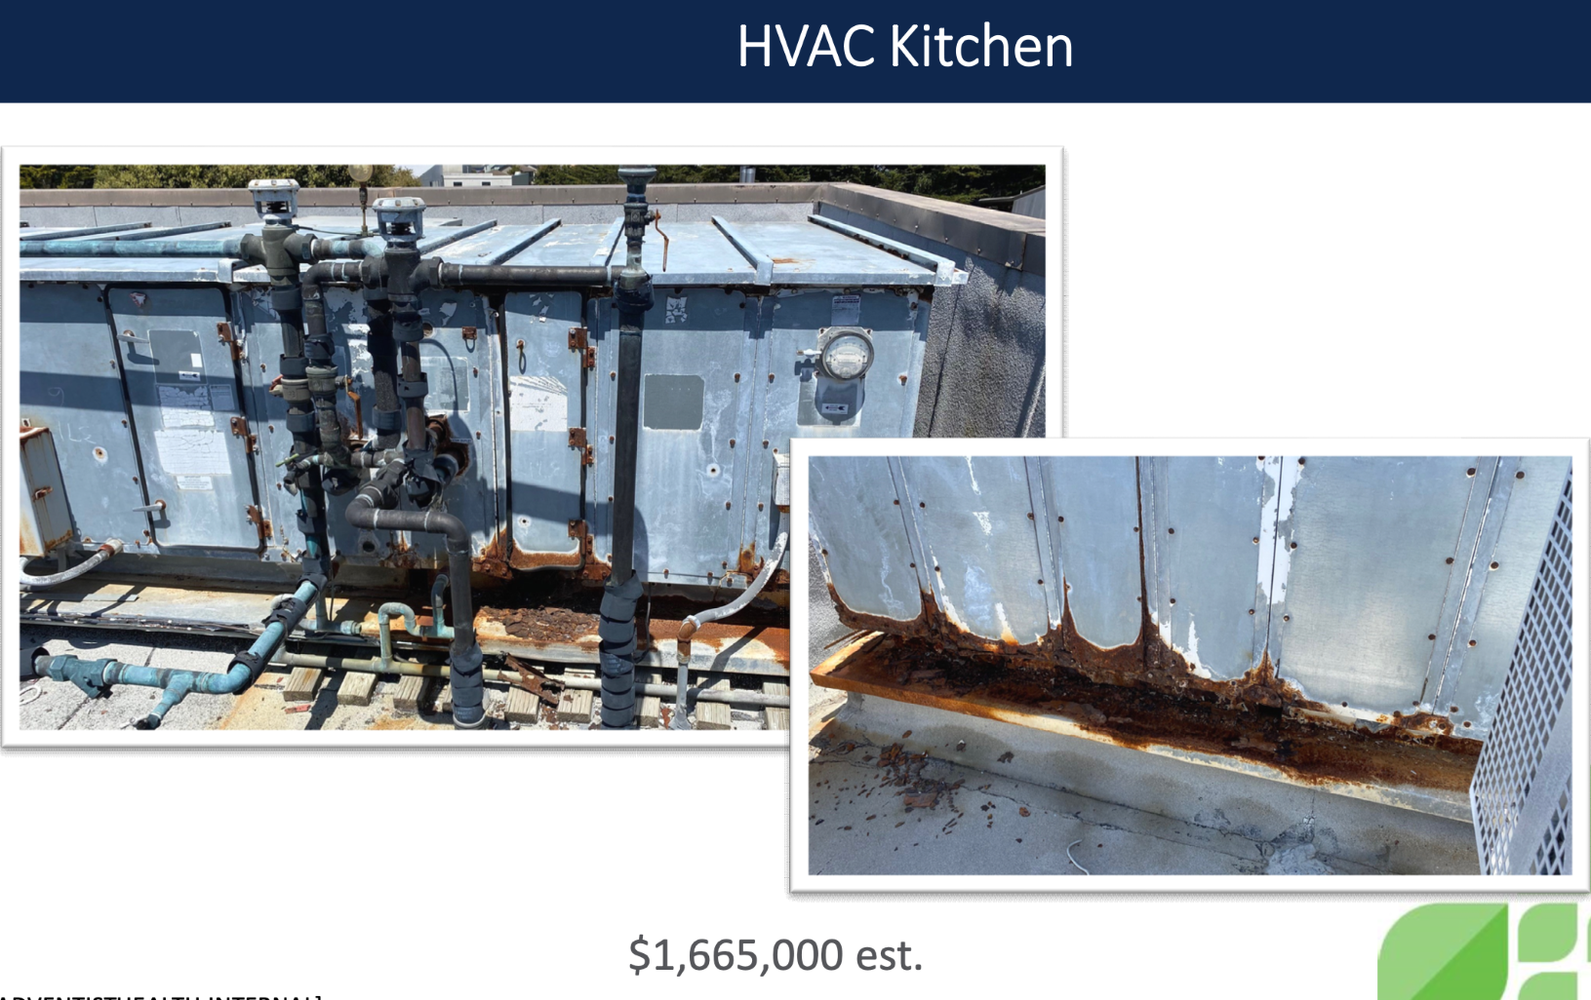
Immediate actions
Approve a maintenance plan in June to address about $9 M in deferred maintenance
Develop a plan for facility upgrades/seismic retrofit. Required by January 1, 2025 to continuation of State support for pre-development and maybe construction
Identify grant sources funding of facilities
Continue to engage our community in a conversation about the hospital and health care in our community

Slide 11
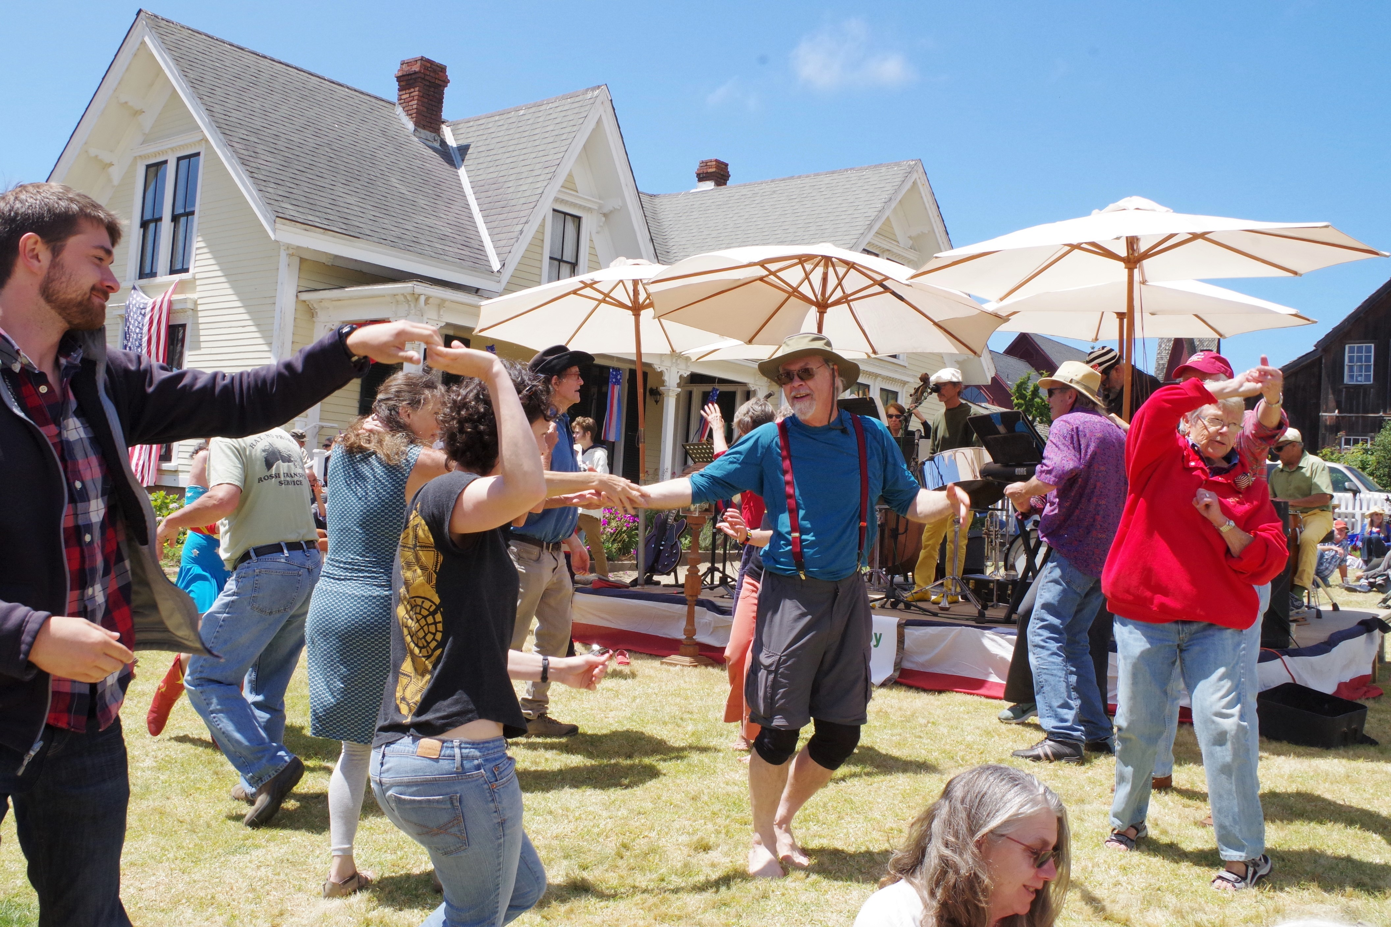
Long term vision
Ensure the financial viability of our Hospital (note: did not say make it profitable for AH – it must be profitable to continue to serve our community)
Modernize and expand facilities to offer more services
Secure future financial stability through strategic investments, increasing philanthropy and strategic investments
Create for the long-term, a community hospital that provides high-quality medical services meeting the needs of our residents.

